Slide 1

SLICKTEK
DEFINING THE FUTURE OF WORKSPACE

Slide 2
THE STRATEGY
Build an "Owned-Media First" brand. Engineer organic hype and absolute authority before scaling with influencers.

Slide 3


FUTURISTIC MINIMALISM
THE VIBE
THE VOICE
Cyber-minimalism meets precision engineering. A blend of premium sci-fi and modern utilitarianism.
Punchy, tech-forward, and zero-fluff. "Engineered for the modern workflow. Zero friction."

Slide 4

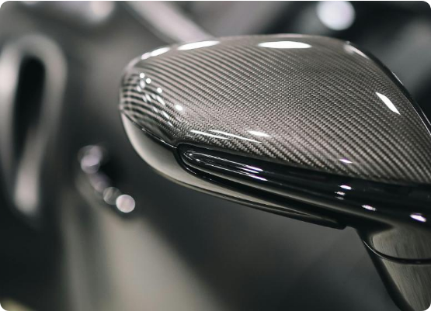
VISUAL LANGUAGE
Deep Blacks: Commanding presence and depth.
Metallic Silvers: Precision and durability feel.
Stark Lighting: Highlighting product edges.
Negative Space: Minimalist, high-end studio aesthetic.

Slide 5
THE SLICKTEK TRIBE
Product Line | Demographic | The Pain Point Solved
SlickTek One (NFC) | Gen Z Hustlers (16-32) | Friction of manual networking.
Desk Gear | WFH Pros & Coders | Clutter and poor aesthetics.
MagSafe Stands | Tech Creators | Flimsy stands for streaming.
EDC Holders | Minimalists | Bulky and disorganized wallets.

Slide 6
PHASE 1: BUILD THE HOUSE
Establish the SlickTek ecosystem before external engagement.

Slide 7
STRATEGIC EXECUTION
Owned Media First: Curate a premium digital ecosystem before scaling.
Daily Connection: Treat social channels like a high-end tech publication.
Exclusivity: Frame lack of influencer spam as a deliberate premium choice.

Slide 8






THE CONTENT PILLARS
CYBER ASMR
ZERO-FRICTION
TRUST BUILDER
Metallic clicks and dark-mode aesthetics. Sensory satisfaction.
POV shots demonstrating speed and instant organization.
Educational lifestyle tech guides and workspace tips.

Slide 9






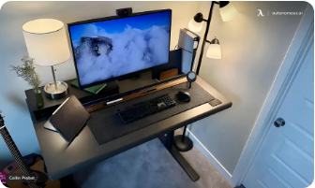

PLATFORM PLAYBOOK
YOUTUBE
INSTAGRAM
TIKTOK
The SEO Anchor. Shorts for growth, Long-form for trust.
The Hype Hub. Trending Reels and BTS Stories.
The Global Ghost-Node. Viral tech reach.

Slide 10
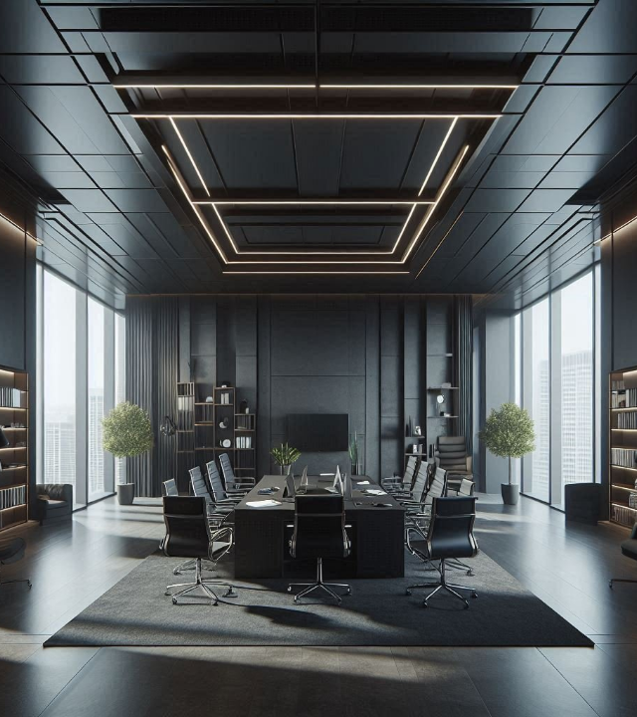
CONTENT FUNNEL
Awareness: Viral reach with Cyber ASMR.
Consideration: Long-form tech deep-dives.
Conversion: Urgency-driven Stories and Drops.

Slide 11
30-DAY LAUNCH CADENCE
WEEK 2
WEEK 4
Utility Reveal
Social Proof
WEEK 1
WEEK 3
Aesthetic Drop
Authority Build

Slide 12
SLICKTEK
Defining the Future of Workspace
Questions?

Slide 13





IMAGE SOURCES
http://carbonfibergear.com/cdn/shop/articles/Black_Carbon_Car_Side_Mirror_pexels_featured_image.jpg?v=1746457195
Source: carbonfibergear.com
https://cdn.autonomous.ai/production/ecm/250327/modern-black-home-office-ideas.webp
Source: www.autonomous.ai
https://images.stockcake.com/public/2/9/7/29722e6f-9545-4adb-88ec-bf5064f9884d_large/neon-coder-setup-stockcake.jpg
Source: stockcake.com
https://static.vecteezy.com/system/resources/previews/035/208/715/non_2x/abstract-digital-technology-hi-tech-futuristic-grey-white-background-cyber-information-communication-innovation-future-tech-data-internet-network-connection-ai-big-data-lines-dots-circuit-vector.jpg
Source: www.vecteezy.com
https://images.squarespace-cdn.com/content/v1/63dde481bbabc6724d988548/50175b61-a0cd-447a-a48c-e3243738a490/16.jpg
Source: www.lorddecor.com

